Slide 1
BIOMEDIN 215 Data Science in Medicine
Alison Callahan, MISt, PhD
acallaha@stanford.edu

Slide 2
Goals for today
Describe the EHRs → clinical data warehouse process at Stanford (using the OMOP CDM)
Design decisions, benefits and drawbacks
Identify the OMOP CDM tables used for the most common EHR data types
Understand the relationship between OMOP CDM data tables and OHDSI Standardized Vocabularies
Know the clinical data science tools and training available on campus, and how to find them

Slide 3
EHRs → clinical data warehouse
Notes:
1:35

Slide 4
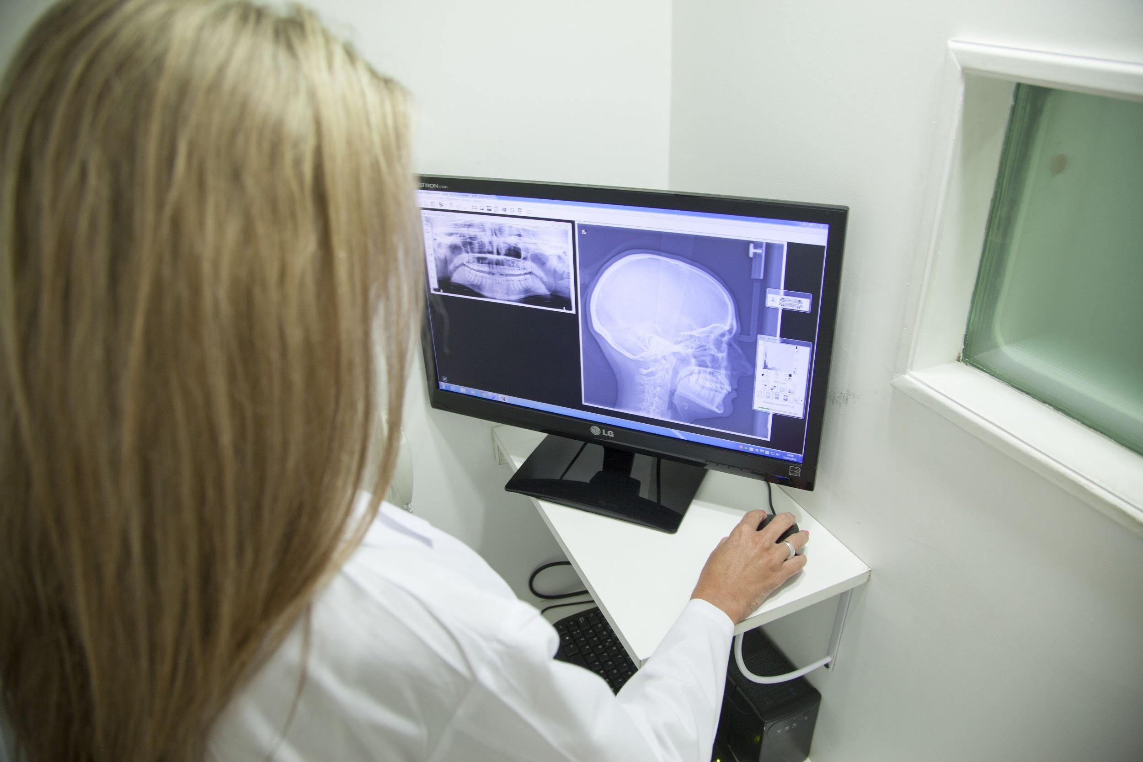
How do data from EHRs end up in our hands?
EPIC
Chronicles
EPIC
Clarity
Research database
Hyperspace Entry (a.k.a. you, or your doctor)
Epic Proprietary Products

Slide 5
EHR data are prepared for research via an ETL process
E: Extract
Access, query, download
T: Transform
Apply rules to handle different data types, names, meanings
L: Load
Prepare, upload to research data warehouse

Slide 6
EHR data are prepared for research via an ETL process
EPIC
Chronicles
EPIC
Clarity
Research database
ETL
ETL
Hyperspace Entry (a.k.a. you, or your doctor)
Epic Proprietary Products

Slide 7
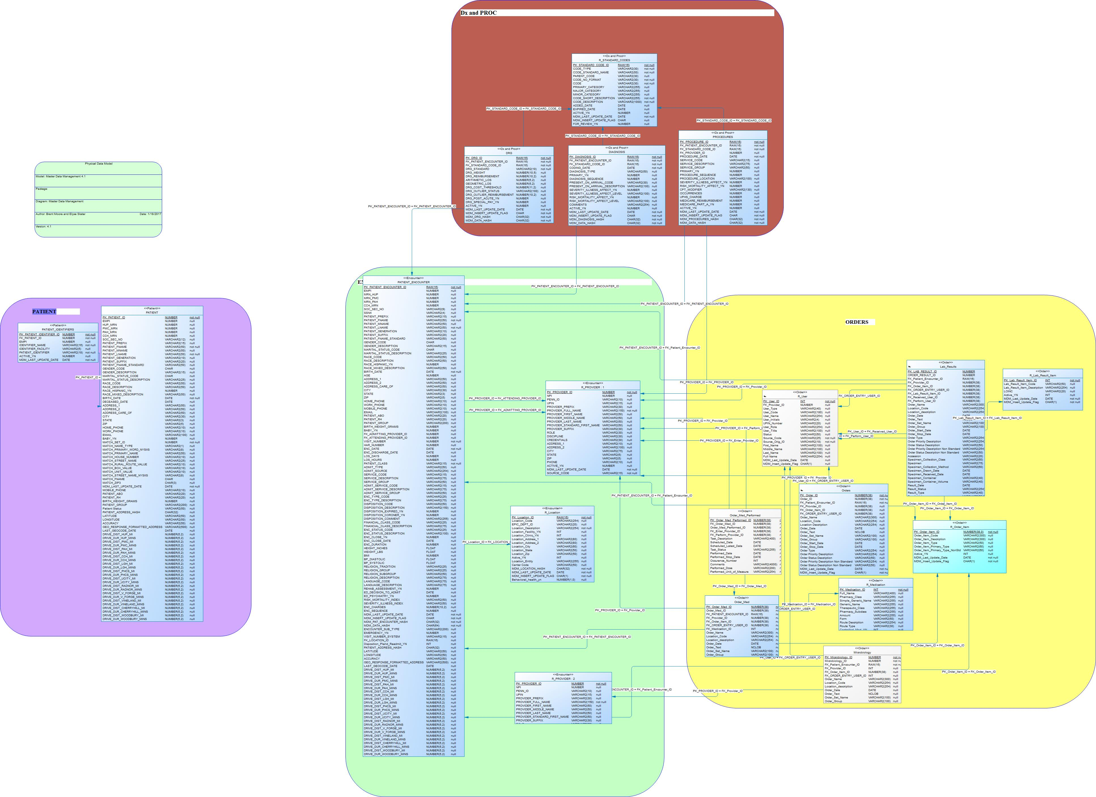
Complex database → complex ETL
UPenn clinical ’master data management model’
Notes:
https://www.med.upenn.edu/dac/penn-data-store-warehouse.html

Slide 8



There are many, many clinical database schemas
When used across institutions and applications, a database schema is known a common data model (CDM)
Notes:
PCORNet – Patient Centered Outcomes Research Network
I2b2 – Informatics for Integrating Biology & the Bedside
MIMIC - Medical Information Mart for Intensive Care

Slide 9

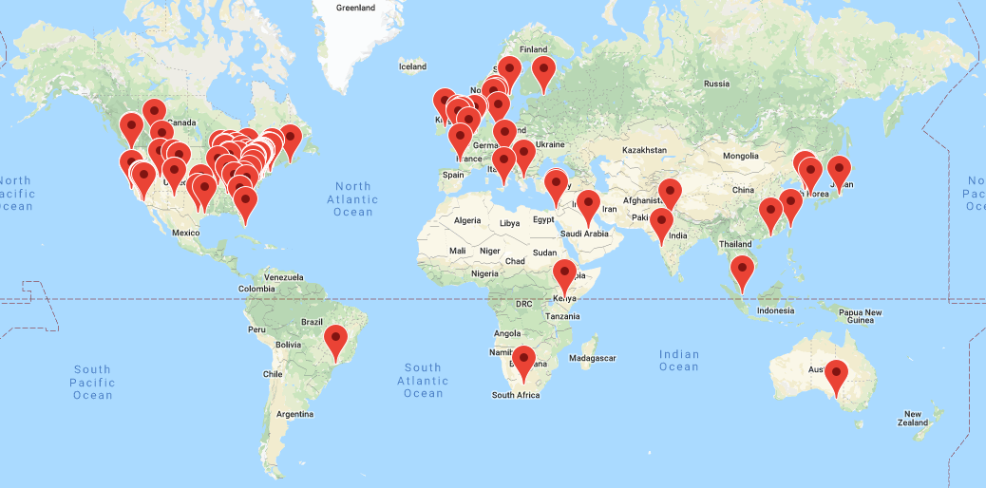
Community adoption is a major driver of CDM design
Notes:
OHDSI Mission
To improve health by empowering a community to collaboratively generate the evidence that promotes better health decisions and better care.
OHDSI Vision
A world in which observational research produces a comprehensive understanding of health and disease.

Slide 10
The flagship “product” of OHDSI is the OMOP CDM
Includes data models and a vocabulary model for medical domain-focused concepts
Patient-centric
Accommodates data from various sources
Preserves data provenance
Extendable
Evolving

Slide 11
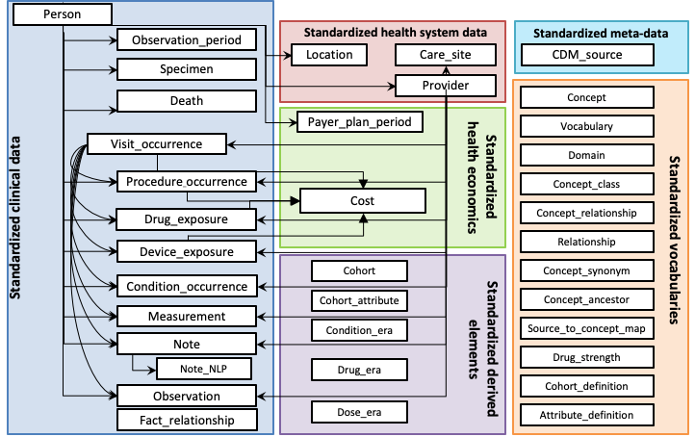
OMOP CDM Version 5.3.1
https://ohdsi.github.io/CommonDataModel/cdm531.html#omop_cdm_v531

Slide 12
ETL to OMOP CDM results in records that are more compact
EPIC
Clarity
OMOP CDM database
~ 300 tables
~ 30 tables

Slide 13
The OMOP CDM tables
Notes:
1:50

Slide 14
PERSON
Uniquely identifies each patient who has at least one clinical observation recorded in the source data
Each PERSON record has demographic attributes which are assumed to be constant for the patient throughout the course of their periods of observation e.g. location or gender is expected to have a unique value per person, even though in life these data may change over time.

Slide 15
CONDITION OCCURRENCE
Contains records of a PERSON suggesting the presence of a disease or medical condition stated as a diagnosis, a sign or a symptom, which is either observed by a PROVIDER or reported by the PERSON
Codes written in the process of establishing the diagnosis, such as “question of” and “rule out”, are not represented here
The visit during which the condition was observed is recorded through a reference to the VISIT OCCURRENCE table
Sources: problem lists, billing diagnosis, admit diagnosis

Slide 16
DRUG EXPOSURE
Contains records about drugs ingested or otherwise introduced into the body.
Drug exposure is inferred from clinical events associated with orders, prescriptions written, pharmacy dispensing, procedural administrations, and other patient-reported information
Notes:
Records in the corresponding drug era mark start and end of drug exposures

Slide 17
MEASUREMENT
Contains records of structured values (numerical or categorical) obtained through systematic and standardized examination or testing of a PERSON or PERSON’s sample.
For example, height, weight, blood pressure, laboratory test results
Includes the order and the result
No free form results: unit has a concept and values are separated for strings and numbers

Slide 18
OBSERVATION
Captures clinical facts about a PERSON obtained in the context of examination, questioning or a procedure. Any data that cannot be represented by any other domains, such as social and lifestyle facts, medical history, family history, etc. are recorded here.

Slide 19
Breakout: Putting data into the OMOP CDM
You have demographic, diagnosis, procedure and medication records from Epic Clarity about an adolescent female seen at LPCH.
Pick one of the CDM data tables and convert the corresponding records into rows in that table.
What data do you keep? Which details do you ignore?
Notes:
Allocate 10 minutes for this; 2-3 minutes for a 2-3 people to share thoughts
2:00-2:12

Slide 20
Populating the OMOP data tables using the OHDSI vocabularies
Notes:
2:12

Slide 21
Putting data into the OMOP CDM
Create rules to transform source records for each OMOP CDM table
Records from multiple source tables can be merged into a single OMOP CDM table
Details from source tables can be lost in conforming to OMOP CDM table structures

Slide 22
Putting data into the OMOP CDM
Create rules to map source values to concepts from medical terminologies and vocabularies (e.g. SNOMED, ICD10, LOINC)
A source value may not have a code associated with it (labs are the most common case for this), which means manual review is needed to assign one
OHDSI uses its own vocabularies, comprised of 90+ medical ontologies and terminologies

Slide 23

The OHDSI Standardized Vocabularies
Contains Concept records that uniquely identify each fundamental unit of meaning used to express clinical information in all domain tables of the CDM, and the Relationships between them.
Uses SNOMED CT as the ‘Standard’ vocabulary
All other vocabularies are mapped to SNOMED CT
Only standard concepts are used as the primary concept identifier in domain tables
This mapping is a labor of love (and sometimes arbitrary decisions!)
SNOMED CT
VOCABULARY
Notes:
https://ohdsi.github.io/TheBookOfOhdsi/StandardizedVocabularies.html
One concept representing the meaning of each clinical event is designated the Standard. For example, MESH code D001281, CIEL code 148203, SNOMED code 49436004, ICD9CM code 427.31 and Read code G573000 all define “Atrial fibrillation” in the condition domain, but only the SNOMED concept is Standard and represents the condition in the data. The others are designated non-standard or source concepts and mapped to the Standard ones. Standard Concepts are indicated through an “S” in the STANDARD_CONCEPT field. And only these Standard Concepts are used to record data in the CDM fields ”[DOMAIN]_CONCEPT_ID".

Slide 24
OHDSI Concepts
CONCEPT_ID | 4193704
CONCEPT_NAME | Diabetes mellitus without complication
DOMAIN_ID | Condition
VOCABULARY_ID | SNOMED
CONCEPT_CLASS_ID | Clinical Finding
STANDARD_CONCEPT | S
CONCEPT_CODE | 313436004
VALID_START_DATE | 01-Jan-1970
VALID_END_DATE | 31-Dec-2099
INVALID_REASON | Valid
Primary key
English description
Domain
Vocabulary
Class in SNOMED
Source identifier
Valid During time intervals

Slide 25
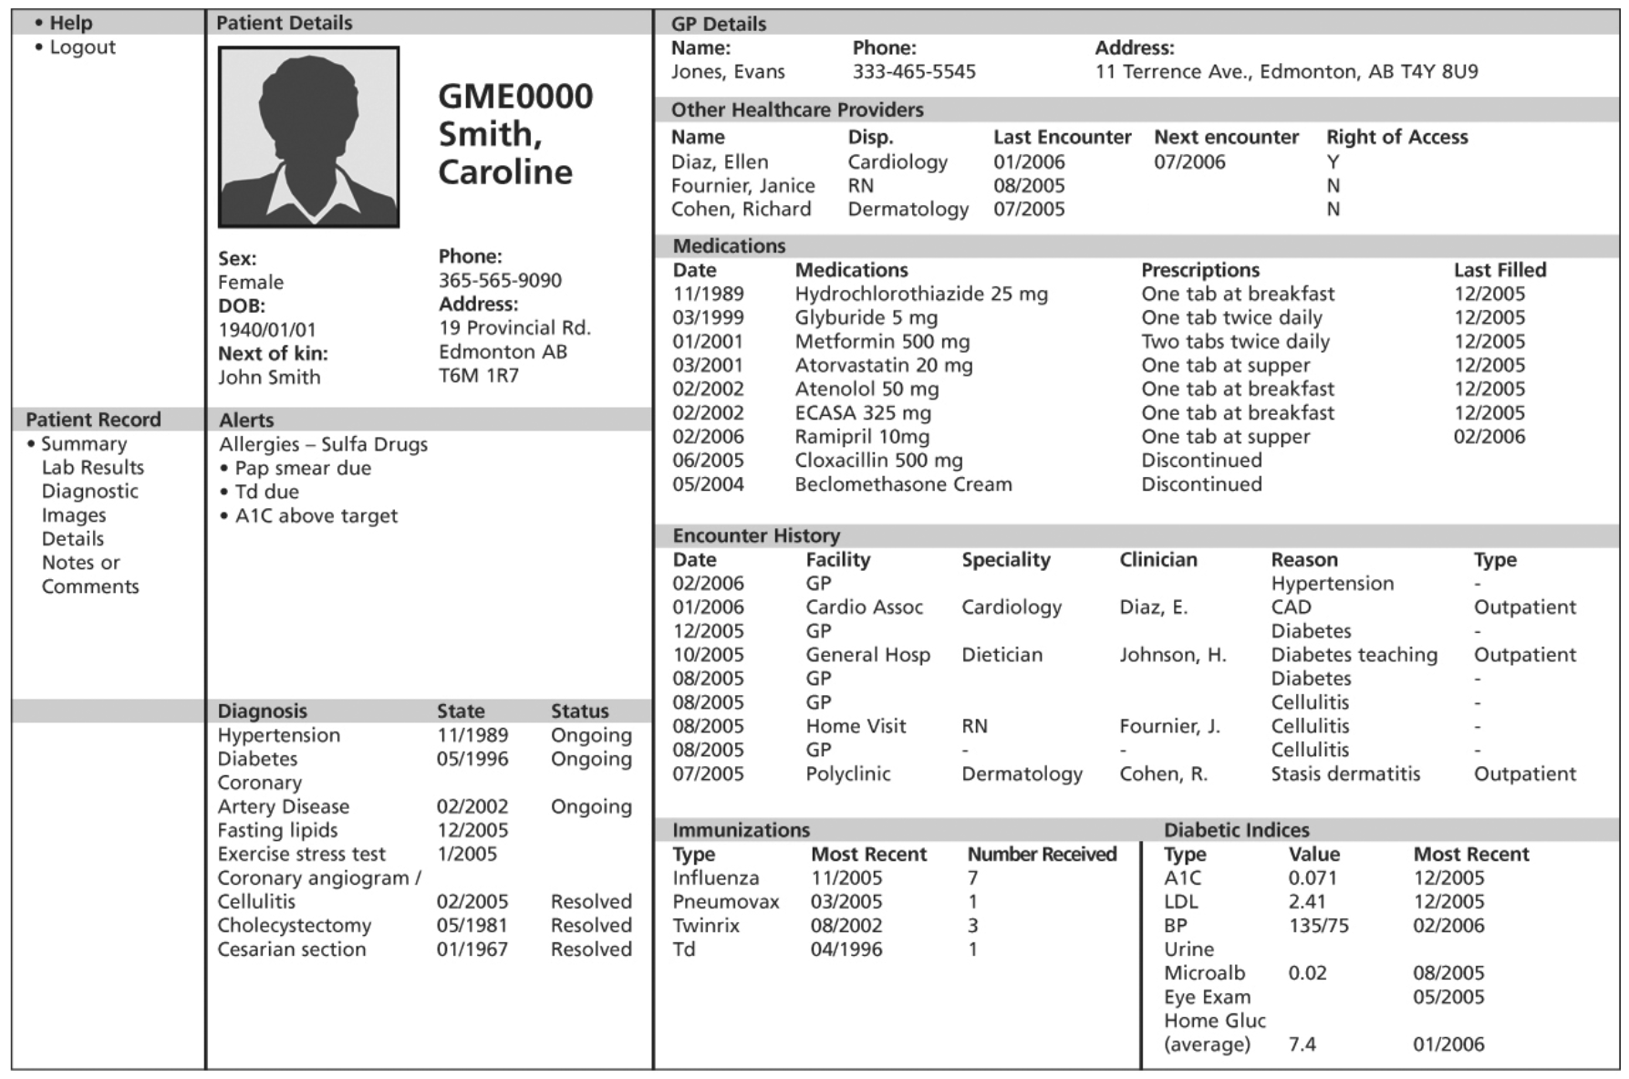
Tying it all together: using Vocabularies with the CDM

Slide 26
Tying it all together: using Vocabularies with the CDM
PATIENT_ID | GME0000
VISIT_ID | 39408757
CONTACT_DATE | 14-Feb-2006
CODE | 250.00
CODE_SOURCE | ICD9CM

Slide 27
Tying it all together: using Vocabularies with the CDM
PERSON_ID | GME0000
CONDITION_CONCEPT_ID
CONDITION_START_DATE | 14-Feb-2006
CONDITION_SOURCE_VALUE | 250.00
CONDITION_SOURCE_CONCEPT_ID
PATIENT_ID | GME0000
VISIT_ID | 39408757
CONTACT_DATE | 14-Feb-2006
CODE | 250.00
CODE_SOURCE | ICD9CM
PERSON_ID
CONDITION_CONCEPT_ID
CONDITION_START_DATE
CONDITION_SOURCE_VALUE
CONDITION_SOURCE_CONCEPT_ID
CONDITION OCCURENCE

Slide 28
Tying it all together: using Vocabularies with the CDM
CONCEPT_ID | 44836914
CONCEPT_NAME | Diabetes mellitus without mention …
DOMAIN_ID | Condition
VOCABULARY_ID | ICD9CM
CONCEPT_CLASS_ID | Clinical Finding
STANDARD_CONCEPT | NULL
CONCEPT_CODE | 250.00
CONCEPT_ID | 4193704
CONCEPT_NAME | Type 2 diabetes mellitus without complication
DOMAIN_ID | Condition
VOCABULARY_ID | SNOMED
CONCEPT_CLASS_ID | Clinical Finding
STANDARD_CONCEPT | S
CONCEPT_CODE | 313436004
Concept
Concept
PATIENT_ID | GME0000
VISIT_ID | 39408757
CONTACT_DATE | 14-Feb-2006
CODE | 250.00
CODE_SOURCE | ICD9CM
PERSON_ID | GME0000
CONDITION_CONCEPT_ID
CONDITION_START_DATE | 14-Feb-2006
CONDITION_SOURCE_VALUE | 250.00
CONDITION_SOURCE_CONCEPT_ID
PERSON_ID | GME0000
CONDITION_CONCEPT_ID
CONDITION_START_DATE | 14-Feb-2006
CONDITION_SOURCE_VALUE | 250.00
CONDITION_SOURCE_CONCEPT_ID | 44836914
PERSON_ID | GME0000
CONDITION_CONCEPT_ID | 4193704
CONDITION_START_DATE | 14-Feb-2006
CONDITION_SOURCE_VALUE | 250.00
CONDITION_SOURCE_CONCEPT_ID | 44836914
CONDITION OCCURENCE

Slide 29
Getting data out of the OMOP CDM
You are conducting a descriptive study of patients with type 2 diabetes, using an OMOP CDM database.
How would you determine which patients have type 2 diabetes and when they were diagnosed?
Which tables would you look in?
Notes:
Ask to share answers.
2:27-2:35

Slide 30
Working with Stanford’s OMOP CDM data
Why?
Infrastructure for data access
Tools for data analysis
Training and support
Notes:
2:35

Slide 31
What does this effort get us?
Open source, maintained statistical analysis packages that run on the OMOP CDM
Connection to an engaged, active, open science community
Notes:
Automated data quality checking
Built-in vocabulary merging

Slide 32
20 minutes to run a study!
Question: In patients with ALS, are specific antidepressants associated with longer survival?
Data: Optum Clinformatics insurance claims
Analysis: a cohort study using OHDSI’s CohortMethod package
Notes:
Context: Lab alumnus who is now UCLA faculty asked this question using VHA data, wanted to know what the answer would be using claims data.

Slide 33
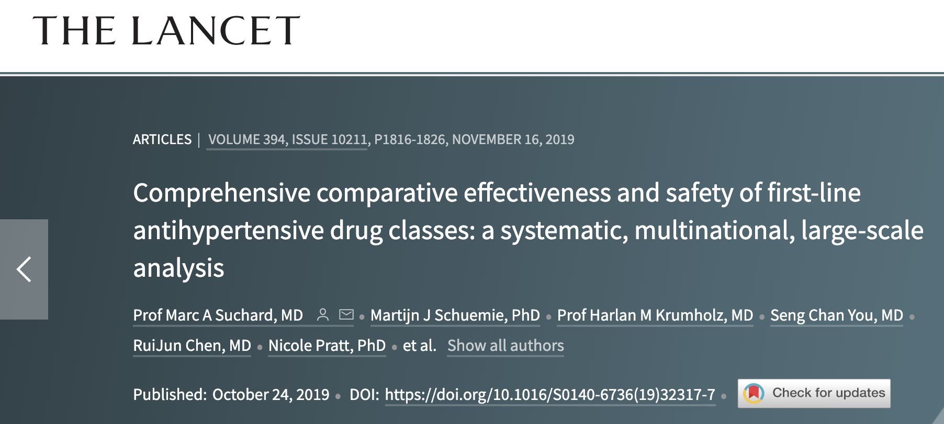
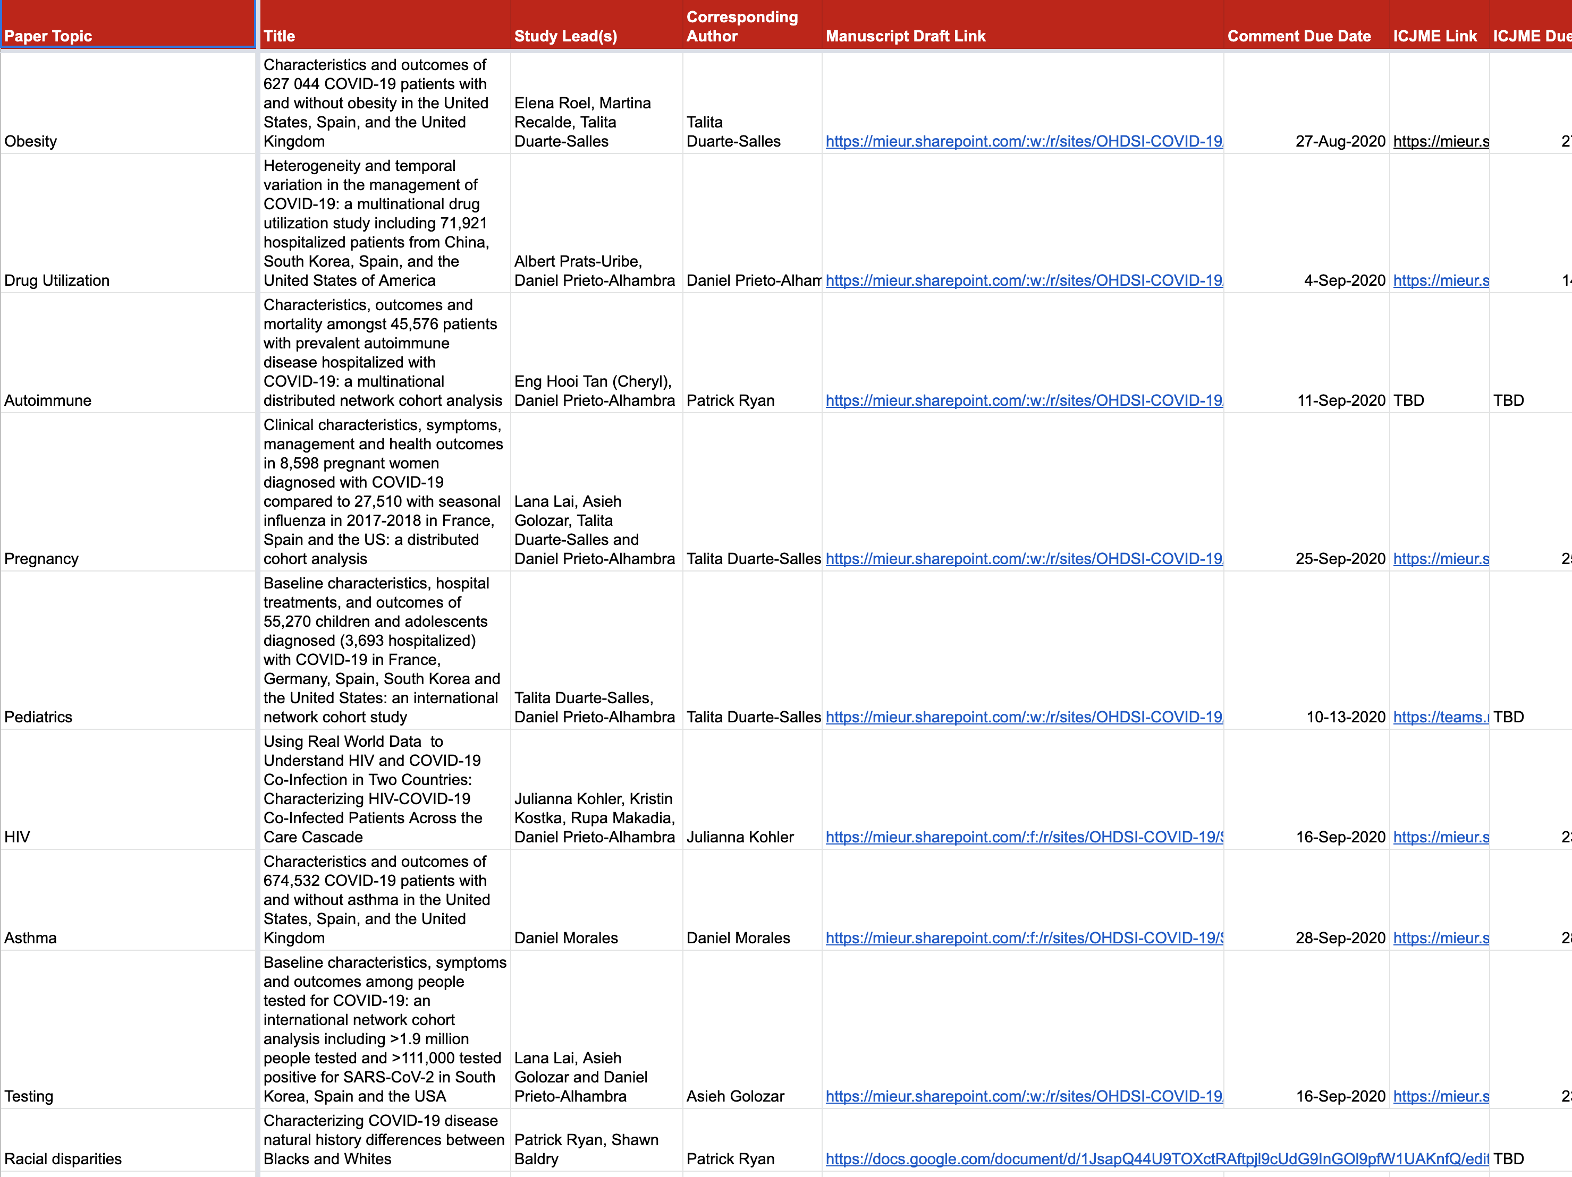
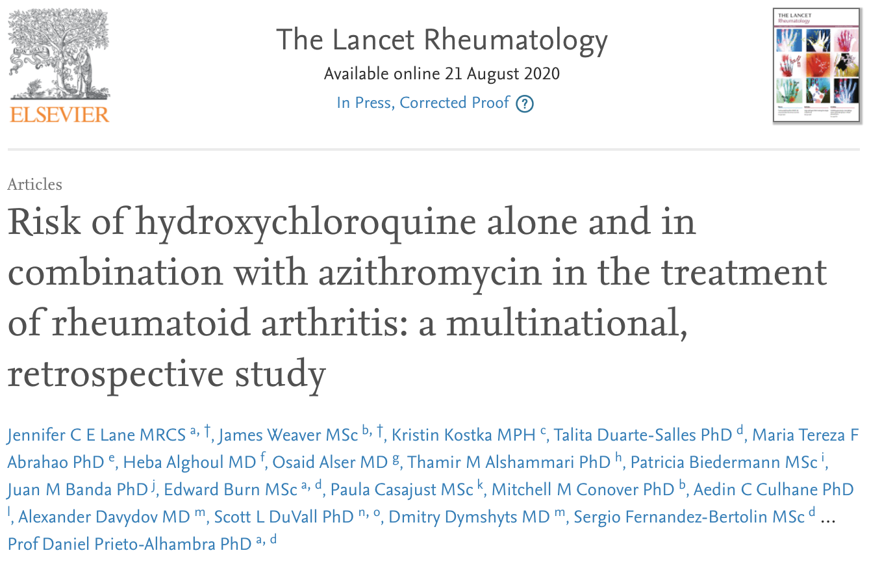
Notes:
282 collaborators at study a thon!

Slide 34
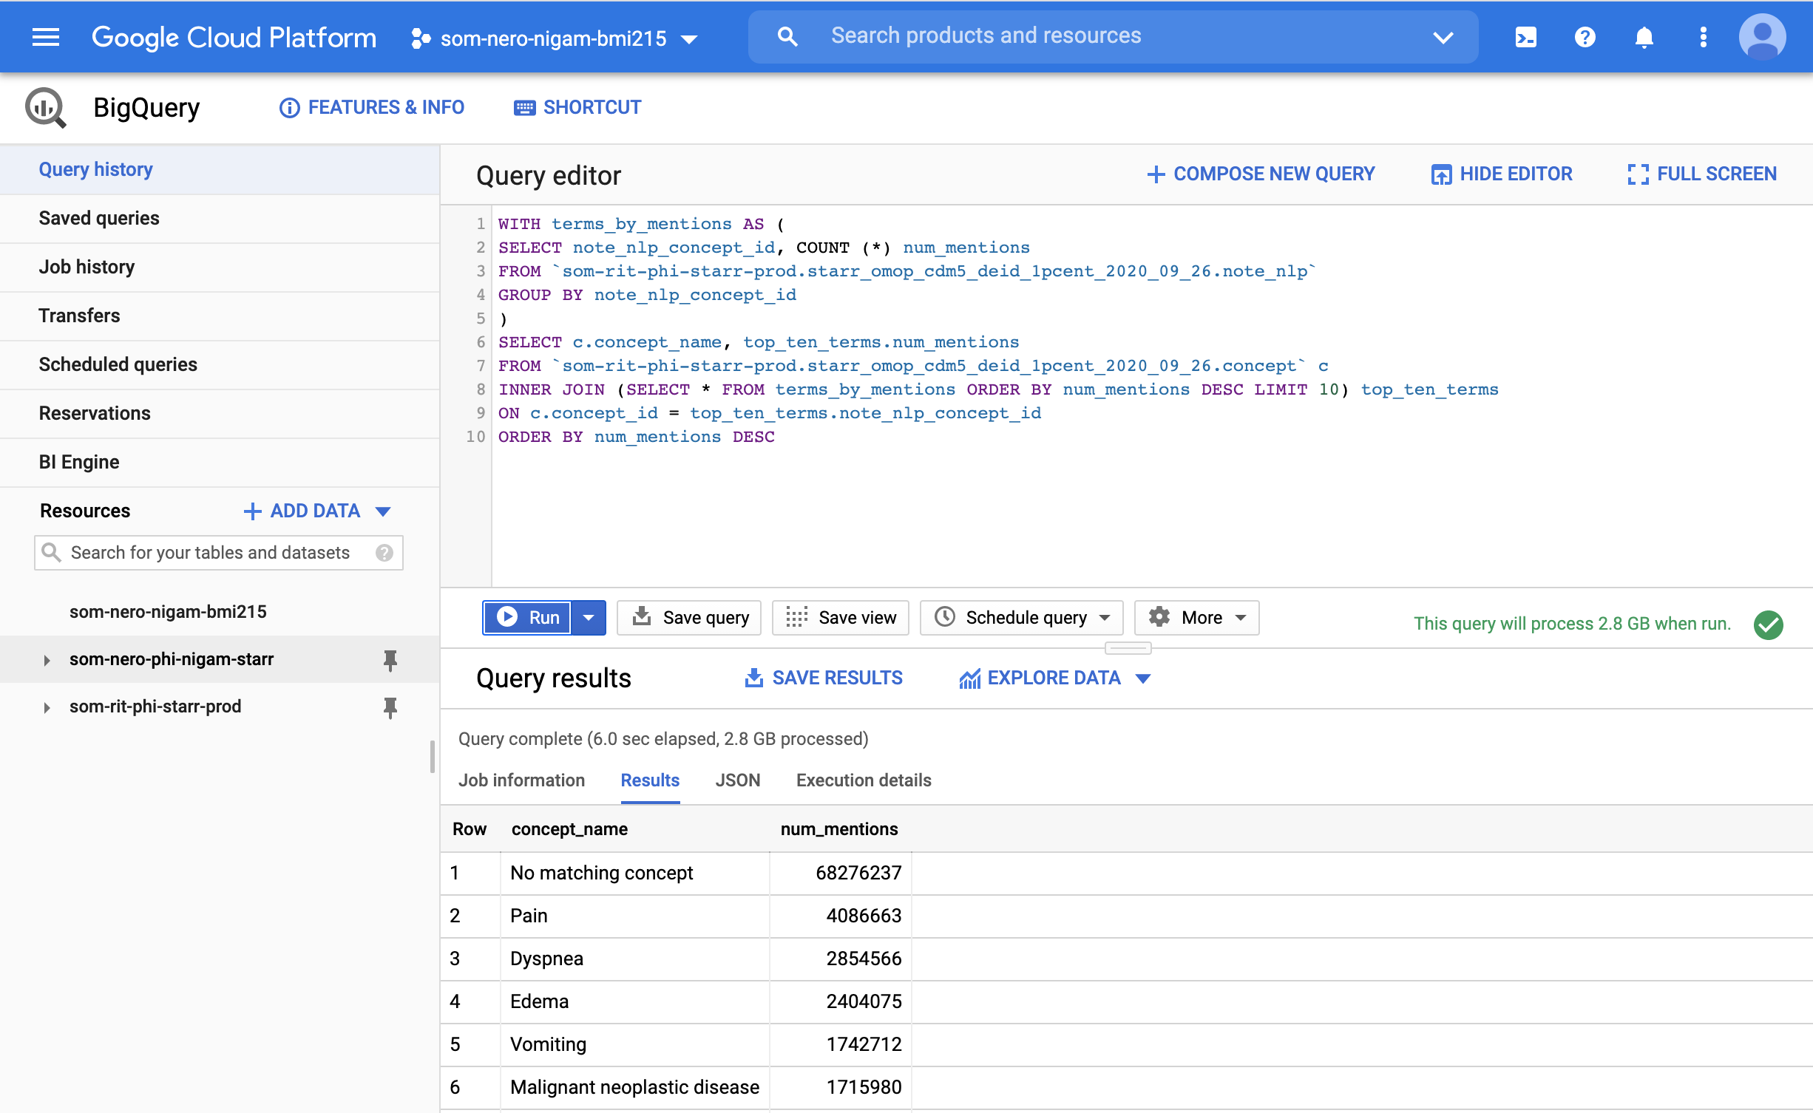
Direct SQL access via BigQuery

Slide 35
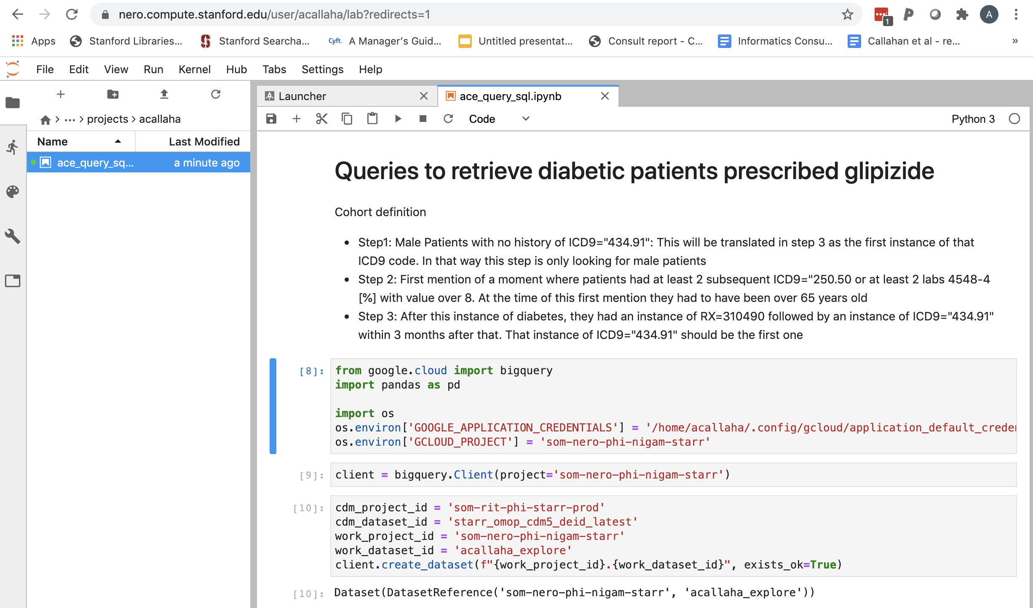
Query + analysis via Jupyter notebooks
https://code.stanford.edu/starr/nero-starr-notebooks/

Slide 36
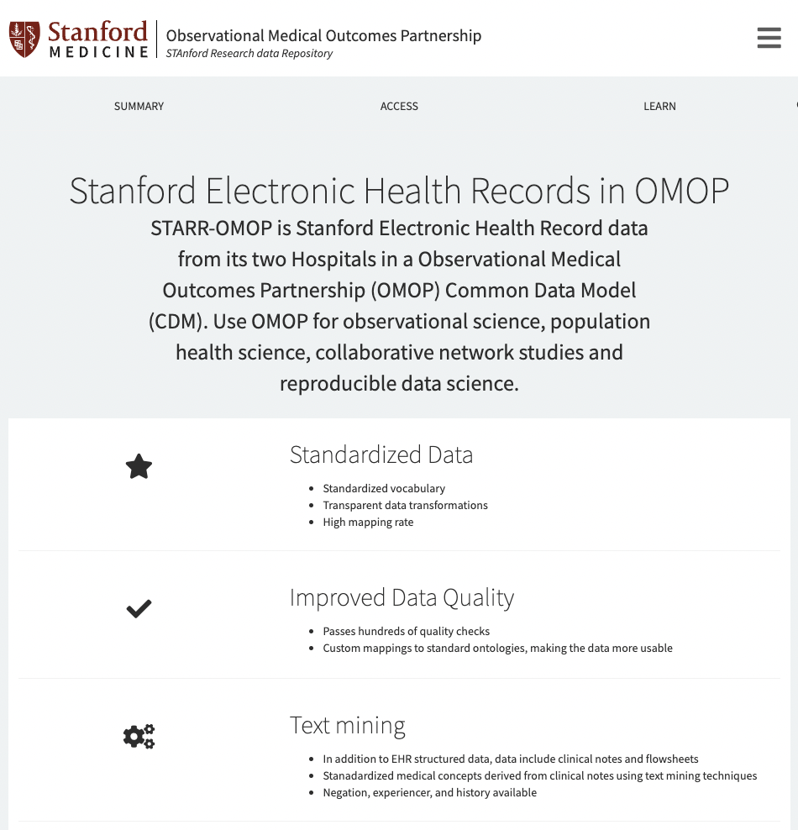
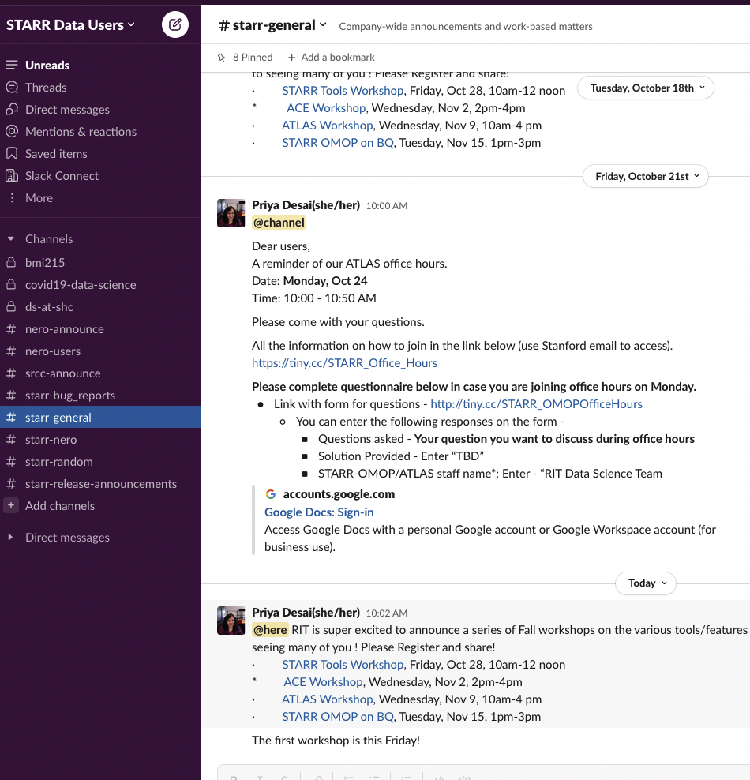
Online training and resources
https://med.stanford.edu/starr-omop.html
https://starrdatausers.slack.com

Slide 37
Remember
EHR data reflect one version of the truth
CDMs and ETL processes are designed by humans and reflect (sometimes arbitrary) decisions, which may change the data substantially
Different sites can use the OMOP CDM differently, which may change the results of analyses

Slide 38
Ready for the hands-on session?
Complete the Lecture 10 Preparation assignment (released last Tuesday)
Office hours if you need help: Wednesday 9-10 AM with Maggie
Post on Canvas if you’re having issues
Bring your laptop to class – working in groups is welcomed and encouraged!

Slide 39
Self study
Review the slides at the end of this lecture
Read more about the other CDM tables here

Slide 40
VISIT OCCURRENCE
Contains the spans of time a PERSON continuously received medical services from one or more providers at a Care Site in a given setting within the healthcare system.
Visits are different than ‘encounters’
Four types: outpatient care, inpatient confinement, emergency room, and long-term care.

Slide 41
PROCEDURE OCCURRENCE
Contains records of activities or processes ordered by, or carried out by, a healthcare provider on the PERSON for a diagnostic or therapeutic purpose
The visit during which the procedure was performed is recorded through a reference to the VISIT OCCURRENCE table

Slide 42
DRUG ERA
A span of time when the Person is assumed to be exposed to a particular active ingredient. A Drug Era is not the same as a Drug Exposure: Exposures are individual records corresponding to the source when Drug was delivered to the Person, while successive periods of Drug Exposures are combined under certain rules to produce continuous Drug Eras.
Notes:
The OMOP CDM also includes derived tables, which contain records that are created at ETL time based on the content of other tables. An example of this is the DRUG ERA table.

Slide 43
CONDITION ERA
A span of time when the Person is assumed to have a given condition. Similar to Drug Eras, Condition Eras are chronological periods of Condition Occurrence.
Allows aggregation of chronic conditions that require frequent ongoing care, instead of treating each Condition Occurrence as an independent event.
Allows aggregation of multiple, closely timed visits for the same Condition to avoid double-counting the Condition Occurrences.

Slide 44
Variable naming conventions
Field name | Purpose | Example
<entity>_id | Unique identifiers for entities (row numbers, or IDs imported from source) | person_id 1234567 visit_occurrence_id 7654321 could be a person identifier or an autogenerated number by the CDM builder

Slide 45
Variable naming conventions
Field name | Purpose | Example
<entity> _concept_id | Foreign key into the Standard Vocabulary for Standard Concept | condition_concept_id 4193704 (SNOMED "Type 2 diabetes mellitus")
<entity> _source_concept_id | Foreign key into the Standard Vocabulary for Source Concept | condition_source_concept_id 44836914 (ICD9CM "Diabetes mellitus")

Slide 46
Variable naming conventions
Field name | Purpose | Example
<entity> _source_value | Verbatim information from the source data, not to be used in analysis | condition_source_value 250.00 (ICD9CM "Diabetes mellitus…")
<entity> _type_concept_id | Foreign key into the Vocabulary for the origin of the information | condition_type_concept_id 38000199 ("Inpatient header – primary")

